Slide 1
Kiruna Innovation Forum The importance of a strong driving force and a clear goal
SSC – a motor for regional/national innovation within space and a strategic asset for Europe
Stefan Gardefjord
20 September 2023

Slide 4
ESRANGE SPACE CENTER
The most Versatile and Sustainable Space Center in the world

Slide 6
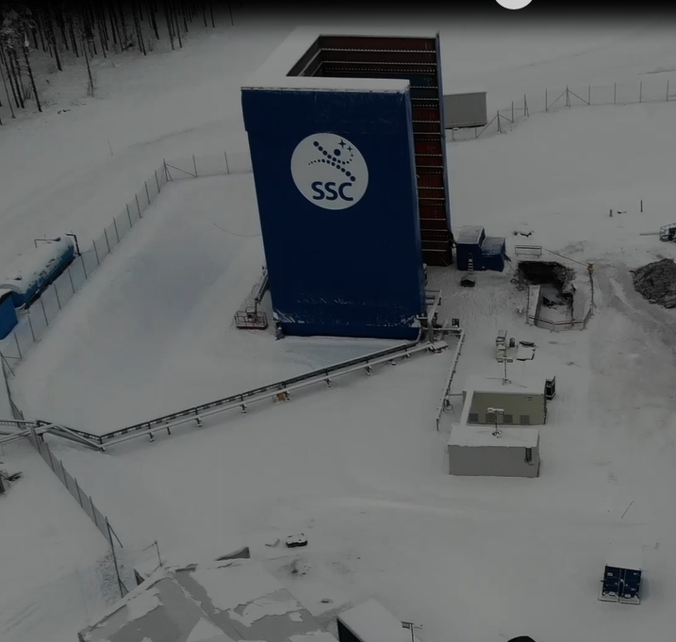
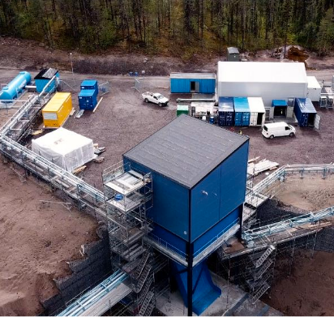
VERTICAL TEST STANDS
ROCKET ENGINE AND STAGE TESTING

Slide 7
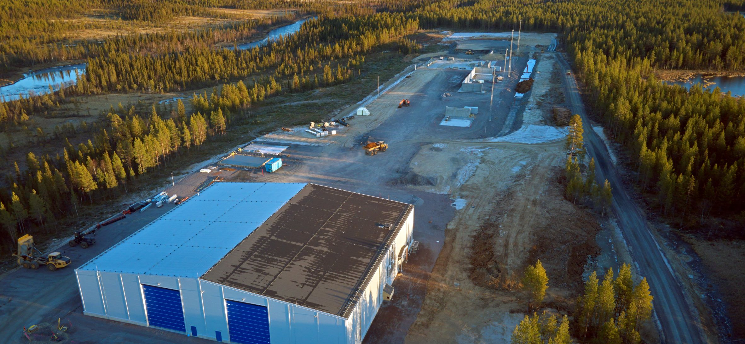
SPACEPORT ESRANGE
LAUNCG COMPLEX 3

Slide 8
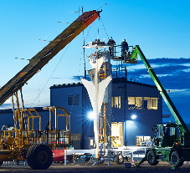
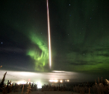
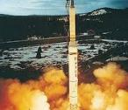
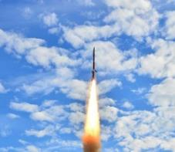
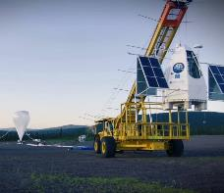
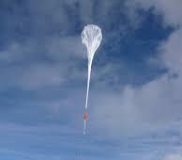
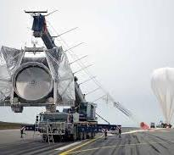
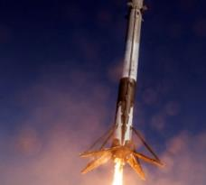
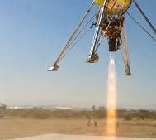
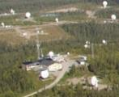
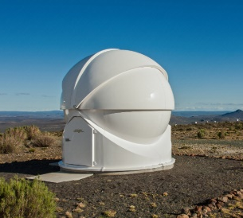
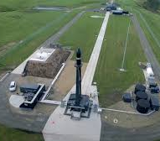
ESRANGE SPACE CENTER
Current services
The most Versatile and Sustainable Space Center in the world
Coming services
Suborbital Rocket Launches
Stratospheric Balloon Launches
Aurora and Atmospheric Science
Microgravity and
Atmospheric Reentry
Student Missions
Rideshare Missions Suborbital Express
Cirumpolar Balloon Flights
Drop Tests
Student Missions
Mobile Ballooning
Test Services
Ground Network Services
Orbital Satellite Launches
Vertical Stage Teststands
Reusability Tests
Planetary Landers
SSC Global Antenna
Network
Space Domain
Awareness
Spaceport Services
Satellite Launch
Service Provider
Testbed Esrange
Spaceport Esrange

Slide 9
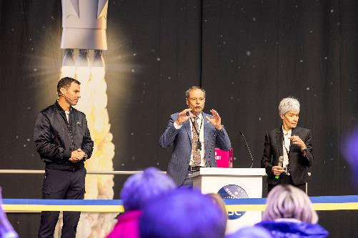
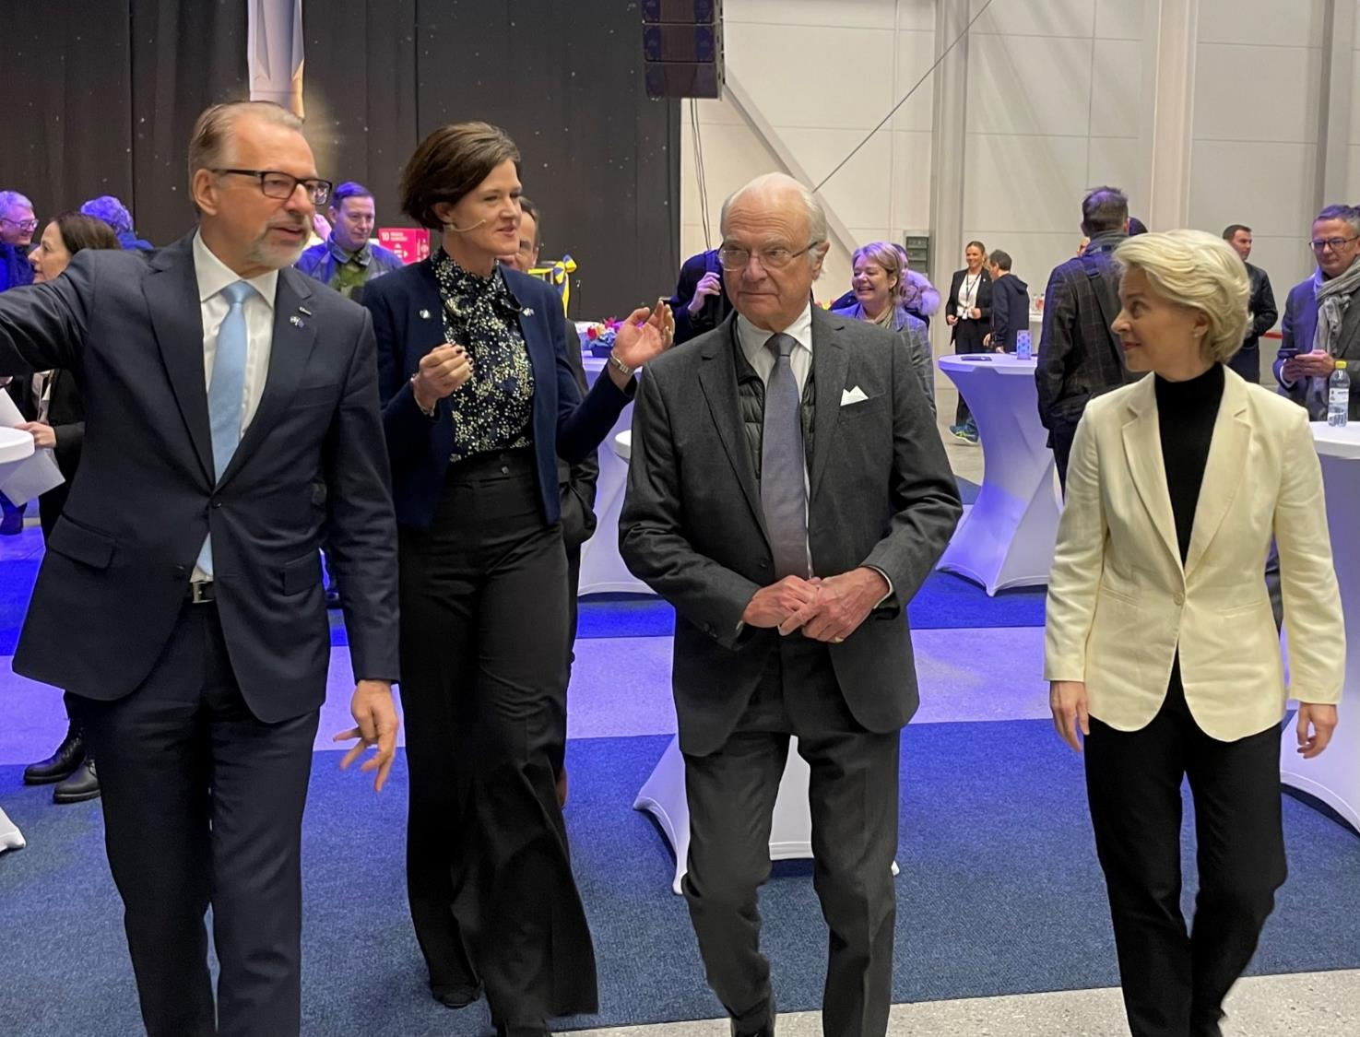
Inauguration Spaceport Esrange A manifestation of Esrange and European Space Capability

Slide 10
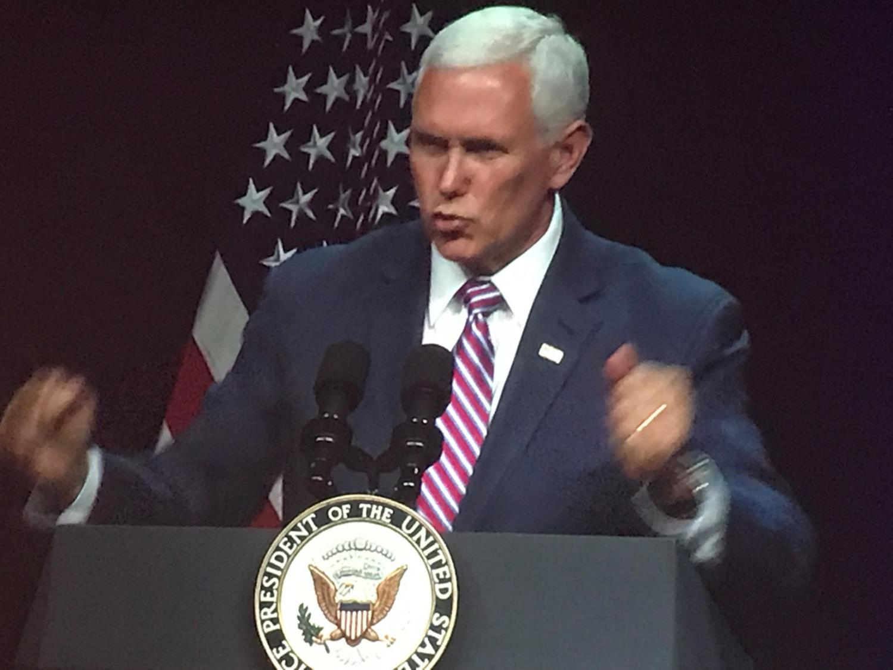

Slide 12
Capability Roadmap
So far…
Acceptance test
Testbed Esrange
Stage test
Local production
Spaceport Esrange
Engine test
Launch Service Provider
Hop-tests
Low-altitude flight
High-altitude flight downrange
Resuasability
Commercial reusable launch

Slide 13
Capability Roadmap
LEOP, TT&C..
Going forward…
Satellite operations
Acceptance test
Stage test
Local production
Spaceport Esrange
New Esrange
Engine test
Launch Service Provider
Hop-tests
Low-altitude flight
High-altitude flight downrange
Commercial reusable launch

Slide 14
Capability Roadmap
ISR
Rapid Launch
Swedish Space Hotspot for the future…
Payload development
Defense Mission Launch
SpaceLab
LEOP, TT&C..
Satellite operations
Acceptance test
Data Analytics
Stage test
Local production
Spaceport Esrange
Engine test
New Esrange
Launch Service Provider
Hop-tests
Low-altitude flight
High-altitude flight downrange
Commercial reusable launch

Slide 15
Local Suppliers
National Partners
Global Clients & Partners

